Slide 1
Pre-Calc & Trig Mr. Cuddy
Room 123

Slide 2
What are you expecting from this class? What are you excited about? What are your questions, concerns, etc.?

Slide 3
Mindsets
In a fixed mindset, people believe their basic qualities, like their intelligence or talent, are simply fixed traits. They also believe that talent alone creates success. They’re wrong.
In a growth mindset, people believe that their most basic abilities can be developed through dedication and hard work—brains and talent are just the starting point. This view creates a love of learning and a resilience that is essential for great accomplishment.

Slide 4
5 Growth Mindset Strategies We’ll Use
#1: Use Think-Alouds to Model How to Solve Problems
#2: Ask Questions that Promote a Challenge
#3: Allow for Opportunities when Students Work Together
#4: Provide Time for Students to Share Out How They Solved the Problem
#5: Take Time to Reflect (Including Errors)

Slide 5
Get into groups of 3 with people around you
Objective: How do you count activity?

Slide 6
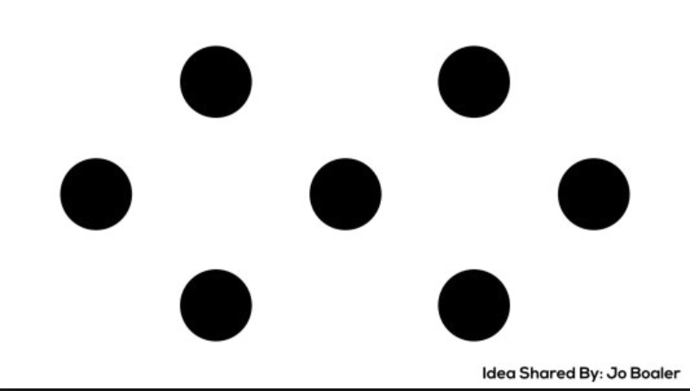
Draw the following shape on your board.

Slide 7
Individually count out how many dots you see, draw out your process on the board.

Slide 8
In your group discuss how each member came to the total. What was similar? What was different?

Slide 9
Whole group share. Can anyone come up with a way we didn’t discus yet?

Slide 10

Draw the following shape on your board.

Slide 11
Individually count out how many dots you see, draw out your process on the board.

Slide 12
In your group discuss how each member came to the total. What was similar? What was different?

Slide 13
Whole group share. Can anyone come up with a way we didn’t discus yet?

Slide 14
Why did we do this exercise? How can we apply this to this class?

Slide 15
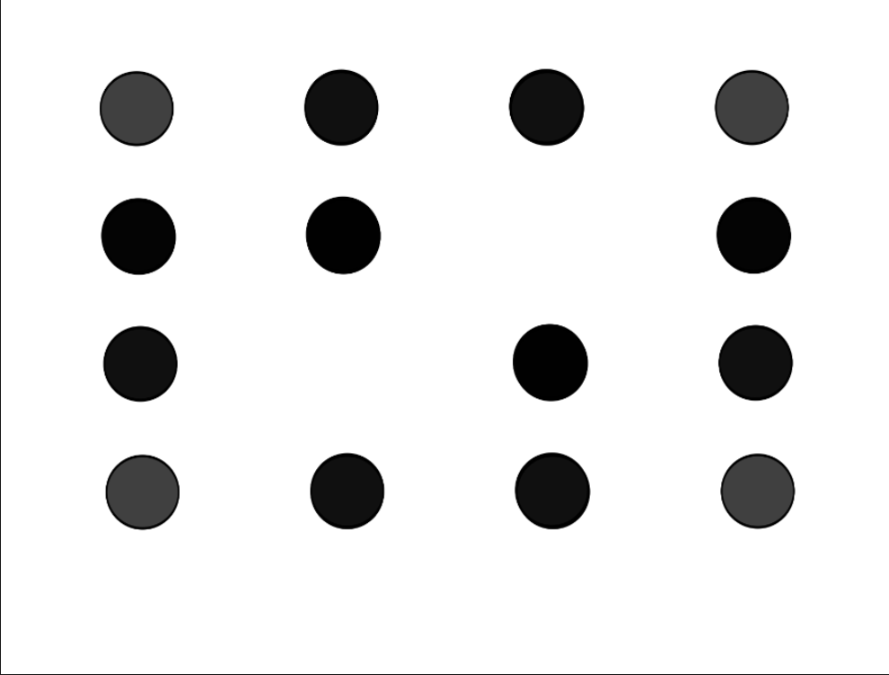
What about the following?

Slide 16

What about the following?

Slide 17
Exit Ticket
What do you want me to know about you in order to make this year the best year you’ve had in a math classroom?

